Slide 1
PyTorch Distributed and Parallel Training - 3
20230419
박현우

Slide 2
Table of Contents
What is RPC-based Distributed Training
Remote Reference Protocol
Distributed Autograd Engine
Using RPC Framework
Combining with DDP
Pipeline Parallelism

Slide 3
What is RPC-based Distributed Training
Needs for RPC-based Distributed training
Advantage of RPC over DDP/FSDP
What is torch.distributed.rpc package
CUDA RPC

Slide 4
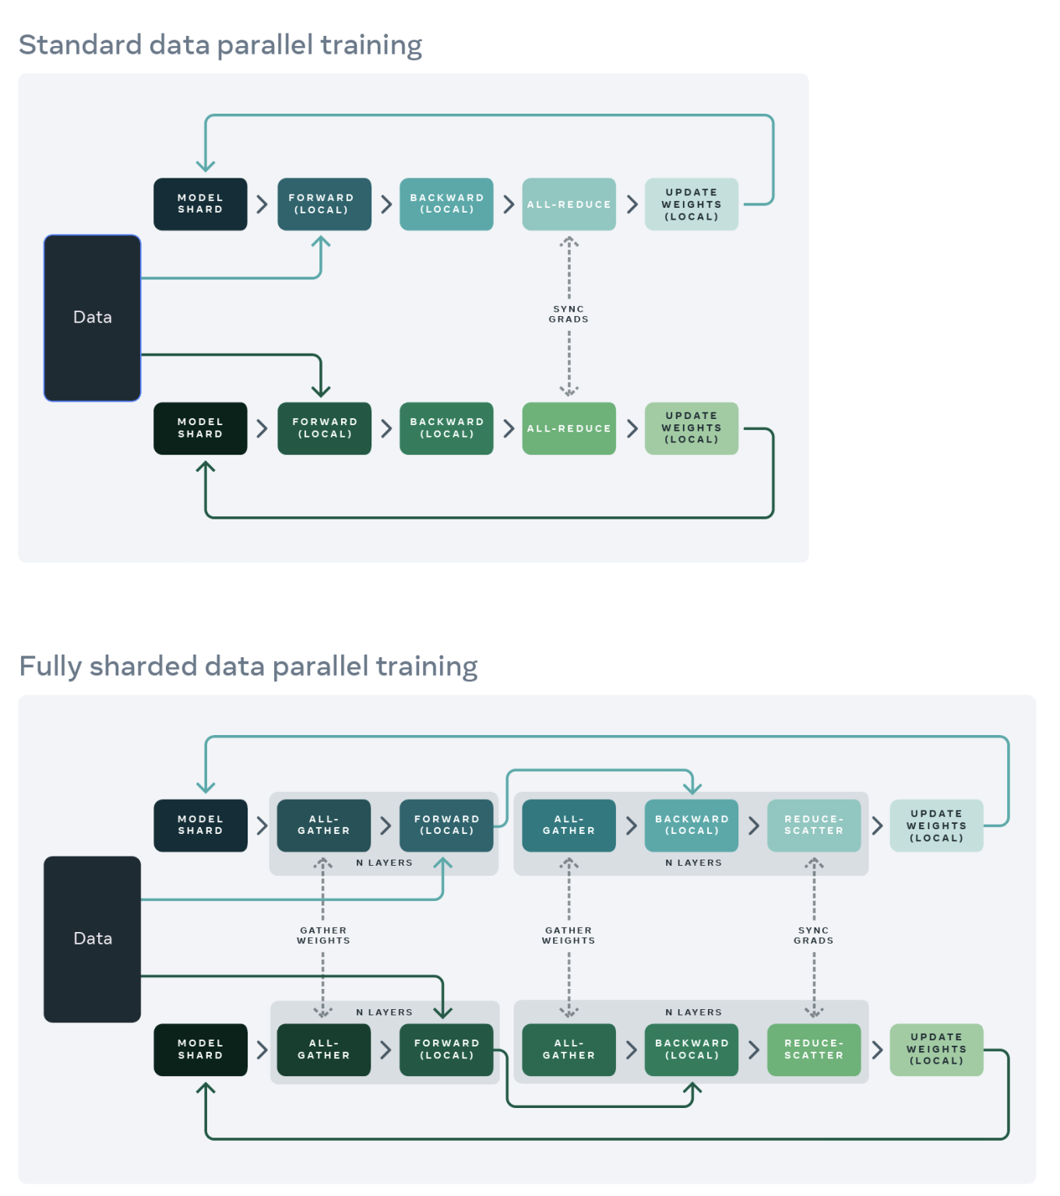
1.1 Needs for RPC-based Distributed Training
DDP/FSDP support very specific training paradigm:
the model is replicated across multiple processes
and each process handles a shard of the input data.

Slide 5
1.1 Needs for RPC-based Distributed Training
Most common scenarios for different training paradigms:
Reinforcement learning
Parameter Server Architecture

Slide 6
1.1 Needs for RPC-based Distributed Training
Reinforcement learning
Expensive to acquire training data from environments while the model itself can be quite small.
Thus, it might be useful
to spawn multiple observers running in parallel
and share a single agent.

Slide 7
1.1 Needs for RPC-based Distributed Training
Parameter Server Architecture
Implement single, centralized server for storing parameters and process requests from multiple trainers in cluster.
a server/set of servers centrally stores parameters, such as large embedding tables,
and several trainers query the parameter servers in order to retrieve the most up to date parameters
and the parameters are synced and updated with gradients from these trainers.

Slide 8
1.2. Advantage of RPC over DDP/FSDP
Suppose a model has very large embedding layer.
For such large embedding lookup, Data/Model parallelism is not efficient, as entire embedding (although sharded) must be floating all around the cluster.
In PS arch, communication can be minimized by
doing parameter lookup in PS first
and then only transferring lookup result.
NOTE : But they are not Mutually exclusive; can be combined together.

Slide 9
1.3. What is torch.distributed.rpc package
In torch.distributed.rpc package,
RPC
for initializing/managing RPC server
RRef (Remote Reference)
for referencing remote value/components as-is on local process
Distributed Autograd
for autograd engine extended for distributed environment
Distributed Optimizer
for optimizers working on distributed environment

Slide 10
1.4. CUDA RPC
Since v1.8, RPC allows users to configure a per-process global device map using the set_device_map API on CUDA,
specifying how to map local devices to remote devices directly.
This removes unnecessary
synchronizations
and D2H and H2D copies.
For example, on worker0’s device map, "worker1" : {"cuda:0" : "cuda:1"}.
The response of an RPC will use the inverse of the caller device map.

Slide 11
1.4. CUDA RPC
Specifically, PyTorch RPC
extracts all Tensors from each request or response into a list
and packs everything else into a binary payload.
Then, TensorPipe will automatically choose a communication channel for each Tensor based on
Tensor device type
and channel availability
on both the caller and the callee.

Slide 12
1.4. CUDA RPC
PyTorch RPC relies on TensorPipe as the communication backend.
TensorPipe abstracts initializing/managing channels for data transportation upon various channel backends.
Existing TensorPipe channels cover
NVLink,
InfiniBand,
SHM (Linux Shared Memory),
CMA (Linux Contiguous Memory Allocator),
TCP, etc.

Slide 13
2. Remote Reference Protocol
What is RRef
Assumptions of RRef Protocol
RRef Lifetime Guarantees

Slide 14
2.1. What is RRef
RRef is a reference of an object located on either
the local
or remote worker,
and can be considered as a distributed shared pointer.
Applications can create an RRef by calling remote()
and Every RRef can be uniquely identified by a global RRefId, assigned at the time of creation on the caller of the remote().

Slide 15
2.1. What is RRef
On the owner worker, there is only one OwnerRRef instance, which contains the real data.
On user workers, there can be as many UserRRefs as necessary, referencing OwnerRRef i.e. UserRRef does not hold the data.
An OwnerRRef (and its data) will be deleted when
there is no UserRRef instances globally
and there are no reference to the OwnerRRef on the owner as well.

Slide 16
2.2. Assumptions of RRef Protocol
RRef protocol is designed with the following assumptions:
Transient Network Failures
Non-idempotent UDFs
Out of Order Message Delivery

Slide 17
2.2. Assumptions of RRef Protocol
Assumption 1 : Transient Network Failures
The RRef design handles transient network failures by retrying messages,
but not handle
node crashes
or permanent network partitions.
When those incidents occur, the application should
take down all workers,
revert to the previous checkpoint,
and resume training.

Slide 18
2.2. Assumptions of RRef Protocol
Assumption 2: Non-idempotent UDFs
User functions (UDF), which use UserRRefs,
are not idempotent
and therefore cannot be retried.
However, internal RRef control messages are
idempotent
and retried upon message failure.

Slide 19
2.2. Assumptions of RRef Protocol
Assumption 3: Out of Order Message Delivery
Protocol doesn’t assume message delivery order between any pair of nodes,
because both sender and receiver are using multiple threads.
Thus, there is no guarantee on which message will be processed first.

Slide 20
2.3. RRef Lifetime
The goal of the protocol is to delete an OwnerRRef at an appropriate time.
i.e.
there are no living UserRRef instances
and user code is not holding references to the OwnerRRef either.
The tricky part is to determine if there are any living UserRRef instances.

Slide 21
2.3. RRef Lifetime Guarantees
Two types of guarantees must be ensured for RRef Protocol:
The owner will be notified when any UserRRef is deleted (G1).
Parent RRef will NOT be deleted until the child RRef is confirmed by the owner (G2).

Slide 22
2.3. RRef Lifetime Guarantees
G1 : The owner will be notified when any UserRRef is deleted.
As messages might come
delayed
or out-of-order,
we need one more guarantee to make sure the delete message is not processed too soon.

Slide 23
2.3. RRef Lifetime Guarantees
G2 : Parent RRef will NOT be deleted until the child RRef is confirmed by the owner.
G2 trivially guarantees that no parent UserRRef can be deleted
before the owner knows all of its children UserRRef instances.

Slide 24
2.3. RRef Lifetime Guarantees
G2 : Parent RRef will NOT be deleted until the child RRef is confirmed by the owner.
However, it is possible that the child UserRRef may be deleted before the owner knows its parent UserRRef.
Nevertheless, this does not cause any problem.
Because,
at least one of the child UserRRef’s ancestors will be alive
and it will prevent the owner from deleting the OwnerRRef.

Slide 25
3. Distributed Autograd Engine
Introduction
Distributed Autograd Engine on Forward Pass
Distributed Autograd Engine on Backward Pass

Slide 26
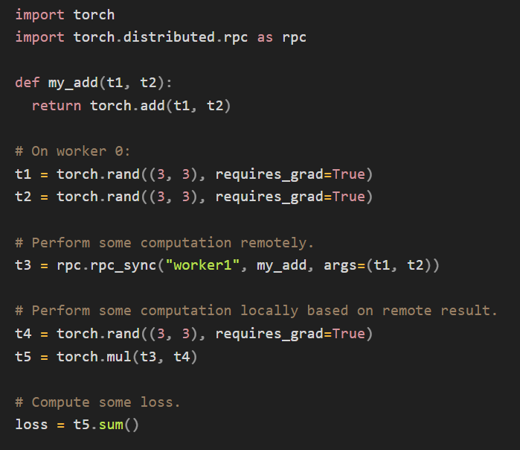
3.1. Introduction
For example, we can have
two nodes
and a very simple model (computation graph),
which is
partitioned across two nodes
and implemented using torch.distributed.rpc:

Slide 27
3.1. Introduction
The main motivation behind distributed autograd is to
enable running a backward pass on such distributed models with the loss that we’ve computed
and record appropriate gradients for all tensors that require gradients.

Slide 28
3.2. Distributed Autograd Engine on Forward Pass
For distributed autograd, we need to keep track of all RPCs during the forward pass for later backward pass.
To do so, we attach send and recv functions to the autograd graph when we perform an RPC.

Slide 29
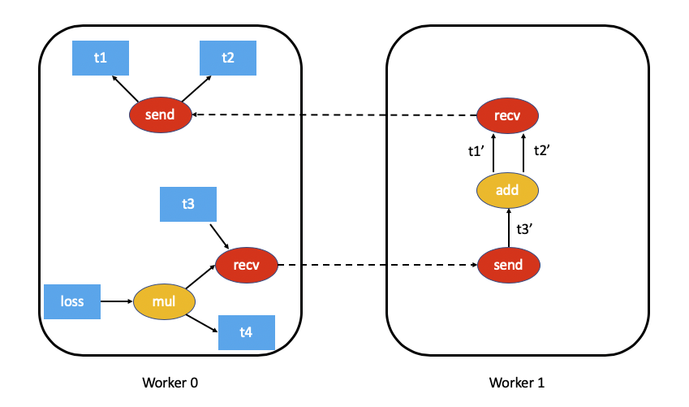
3.2. Distributed Autograd Engine on Forward Pass
Procedures during forward pass - 1
The send function is attached to the source of the RPC i.e. callee of the function (Worker 0)
Also, output edges point to the autograd function for the input tensors of the RPC.
▲ t5.sum() excluded for simplicity

Slide 30
3.2. Distributed Autograd Engine on Forward Pass
Procedures during forward pass - 2
The recv function is attached to the destination of the RPC
and its inputs are retrieved from operators executed on the destination using the input tensors.
i.e. t1’ and t2’ for add ops.

Slide 31
3.2. Distributed Autograd Engine on Forward Pass
Procedures during forward pass - 3
Each send-recv pair is assigned a globally unique autograd_message_id to uniquely identify the pair.
This helps lookup of the corresponding function during backward pass.
This is done using torch.distributed.rpc.RRef.to_here().

Slide 32
3.3. Distributed Autograd Engine on Backward Pass
During backward pass, Distributed Autograd Engine goes through two steps:
Computing dependencies in the autograd graph, to help the engine know when a node in the graph is ready for backward execution.
Applying FAST mode algorithm, to compute gradients.

Slide 33
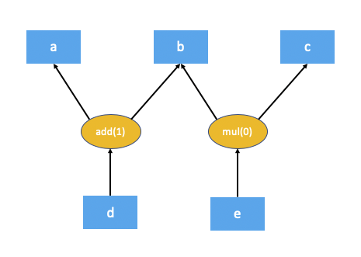
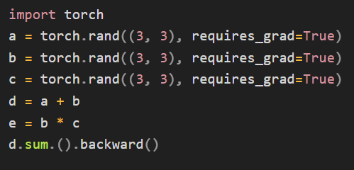
3.3.1. Computing dependencies

Slide 34
3.3.1. Computing dependencies
The numbers in brackets denote the number of dependencies
According to the graph,
the add node needs 1 input (= b)
and the mul node doesn’t need any inputs;
i.e. the mul doesn’t need to be executed for autograd to compute d.sum().backward().

Slide 35
3.3.1. Computing dependencies
The problem here is that certain nodes in the autograd graph might not be executed in the backward pass;
i.e. Due to overhead from distributed nature,
for example, while d is depending on e, e might not be executed at the time d requires e
i.e. while traversing the graph

Slide 36
3.3.2. FAST mode algorithm
Much of such overhead can be avoided by assuming every send and recv function are valid as part of the backward pass
c.f. most applications don’t perform RPCs that aren’t used.
This simplifies the distributed autograd algorithm and is much more efficient, at the cost that few limitations.
This algorithm is called the FAST mode algorithm.

Slide 37
3.3.2. FAST mode algorithm
The key assumption is that each send function has a dependency of 1 when we run a backward pass.
i.e. assume that we’ll receive a gradient over RPC from another node.

Slide 38
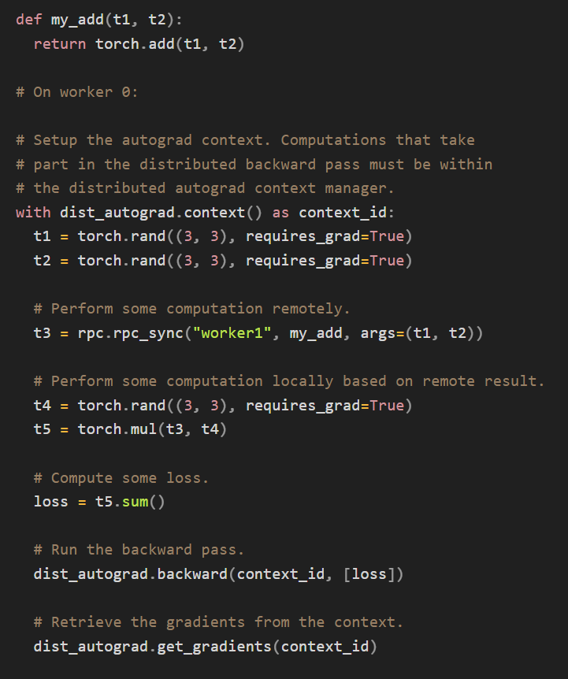
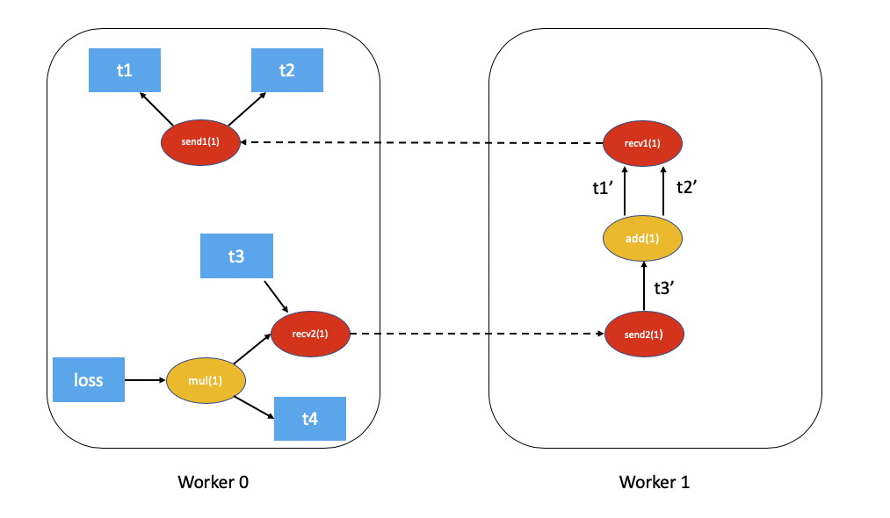
3.3.2. FAST mode algorithm

Slide 39
3.3.2. FAST mode algorithm
FAST mode algorithm - 1
Starting from the worker with the roots for the backward pass - all roots MUST be local -
lookup all the send functions for the current distributed autograd context.
= On Woker 0, loss and send1

Slide 40
3.3.2. FAST mode algorithm
FAST mode algorithm - 2
Compute dependencies locally, starting from
the provided roots
and all the send functions

Slide 41
3.3.2. FAST mode algorithm
FAST mode algorithm - 2
=
first execute the mul function,
accumulate its output in the autograd context as the gradient for t4.

Slide 42
3.3.2. FAST mode algorithm
FAST mode algorithm - 3
When the autograd engine executes the recv function,
the recv function sends the input gradients via RPC to the appropriate worker.
= Execute recv2 which sends the gradients to Worker 1.

Slide 43
3.3.2. FAST mode algorithm
FAST mode algorithm - 4
In 3, the recv function also sends autograd_context_id and autograd_message_id to the remote host.
Using these, lookup the appropriate send function.

Slide 44
3.3.2. FAST mode algorithm
FAST mode algorithm - 5
If this is the first time a worker has received a request for the given autograd_context_id,
it will compute dependencies locally as described in points 1-3 above.

Slide 45
3.3.2. FAST mode algorithm
FAST mode algorithm - 5
= Since this is the first time Worker 1 has heard about this backward pass,
it starts dependency computation
and marks the dependencies for send2, add and recv1 appropriately.

Slide 46
3.3.2. FAST mode algorithm
FAST mode algorithm - 6
The send function retrieved from 5 is then enqueued for execution on the local autograd engine for that worker.
= Enqueue send2 on the local autograd engine of Worker 1, which in turn executes add and recv1.

Slide 47
3.3.2. FAST mode algorithm
FAST mode algorithm - 6
= When recv1 is executed, it sends the gradients over to Worker 0.
Since Worker 0 has already computed dependencies for this backward pass,
it just enqueues
and executes send1 locally.

Slide 48
3.3.2. FAST mode algorithm
FAST mode algorithm - 7
Finally, instead of accumulating the gradients on the .grad field of the Tensor,
we accumulate the gradients separately per Distributed Autograd Context.
= Finally, gradients are accumulated for t1, t2 and t4 in the Distributed Autograd Context.

Slide 49
3.3.2. FAST mode algorithm
In the general case, it might not be necessary that every send and recv function is valid as part of the backward pass.
To address this, SMART mode algorithm is proposed.
But currently, only the FAST mode algorithm is implemented.

